Slide 1

Screen shot

Slide 2
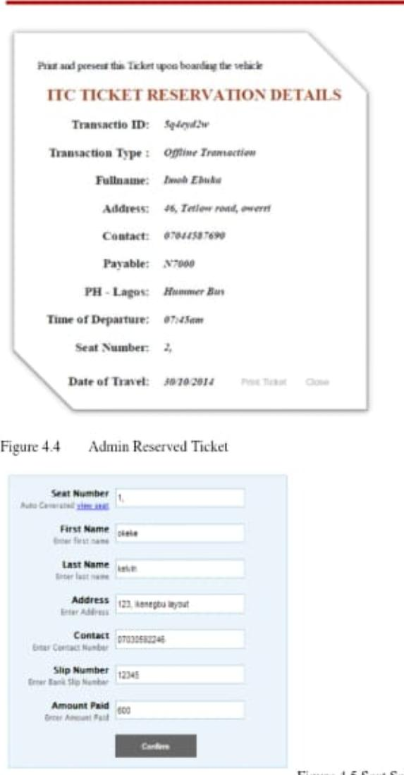

Slide 3
